Slide 1
08 Feb 2024
L-08
AGENDA:
Divide Conquer and Divide Algorithm
Binary Search
Median of Two Sorted Arrays

Slide 2
Binary Search
Binary search or half-interval search algorithm finds the position of a target value within a sorted array.
The binary search algorithm uses divide-and-conquer approach and executes in logarithmic time.
Requirement: Data must be already sorted

Slide 3
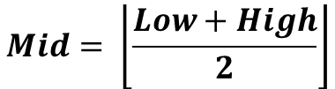
Binary Search(Process)
$$Mid= \left\lfloor \frac{Low+High}{2}\right\rfloor$$
Case 1: Key = A[Mid]
Key=A[Mid]
Low
High
Element is found

Slide 4
Binary Search(Process)
Case 2: Key < A[mid]
Prune Right Half
Key < A[mid]
A[mid]
n/2
High will be updated as
High = Mid -1

Slide 5
Binary Search(Process)
Case 3: Key > A[mid]
Prune Left Half
A[mid]
Key > A[mid]
n/2
Low will be updated as
Low = Mid + 1

Slide 6
Binary Search: Recurrence Relation
T(n) = T(n/2) + k; T(1) = 1
Applying Master Theorem
T(n) = O(logn)

Slide 7
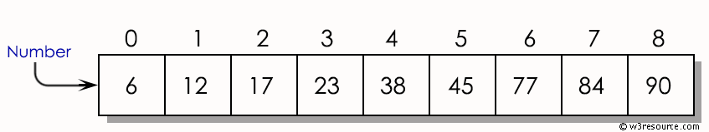
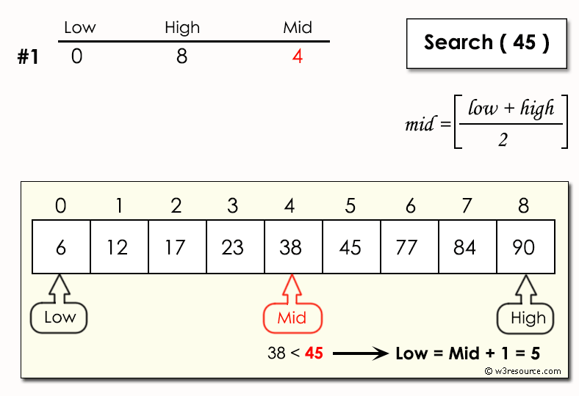
Binary Search

Slide 8
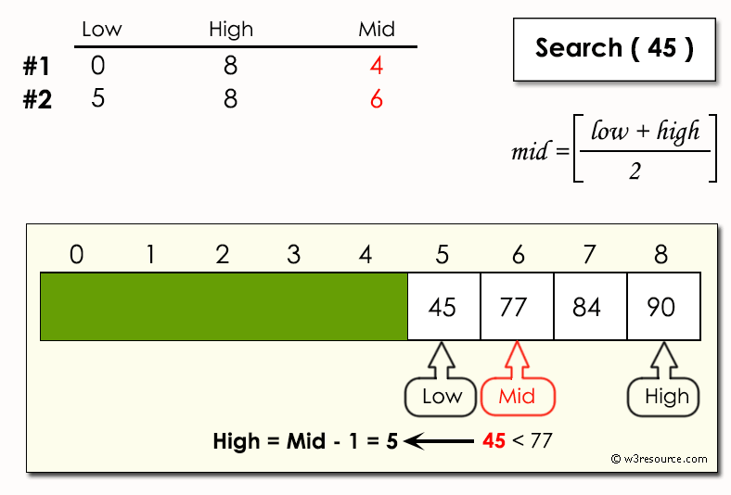
Binary Search

Slide 9
Binary Search: Algorithm
Algorithm: Binary Search
Initialization: Set two pointers, low and high, to the beginning and end of the array, respectively.
Search Loop:
While low is less than or equal to high:
Calculate the middle index: mid = (low + high) / 2.
Compare the middle element arr[mid] with the target element Key.
If arr[mid] is equal to Key, return mid (element found).
If arr[mid] is less than Key, move low to mid + 1 (search in the right half).
If arr[mid] is greater than Key, move high to mid - 1 (search in the left half).
Termination: If the loop exits without finding the target element, return a value indicating that the element was not found (e.g., -1).

Slide 10
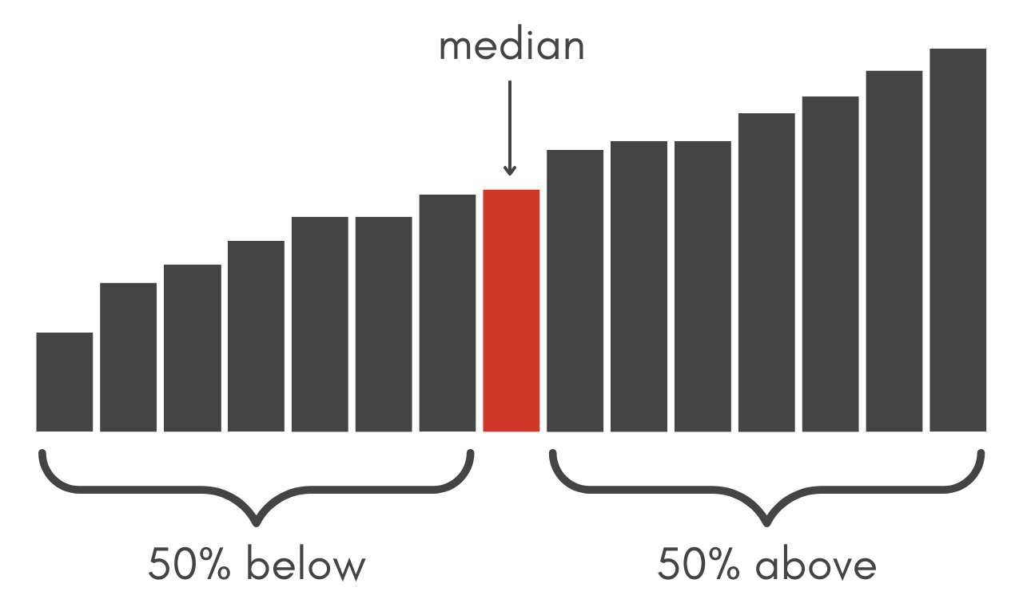
Median
The median is the middle value of a dataset

Slide 11
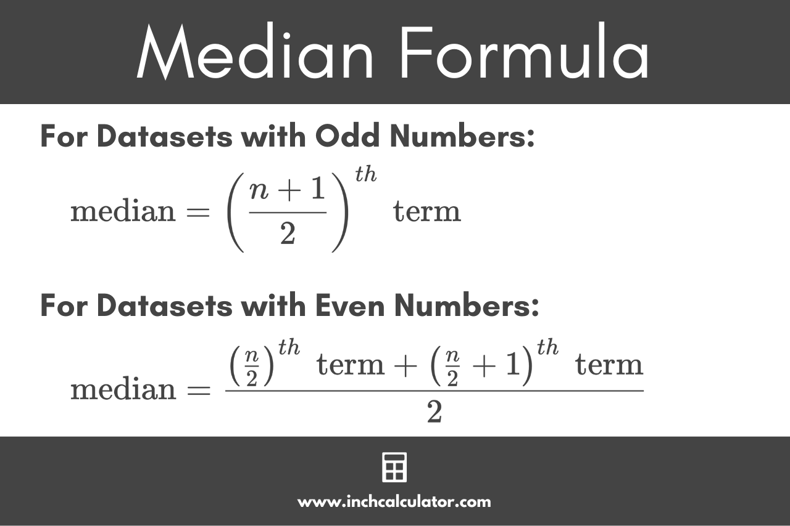
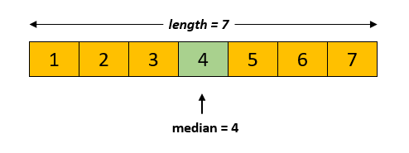
Median

Slide 12
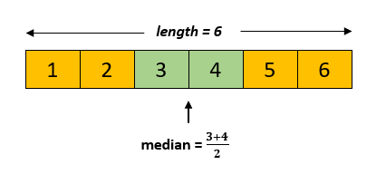
Median

Slide 13
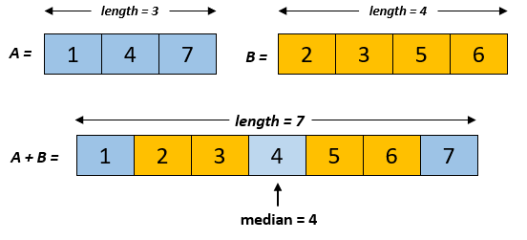
Median of Two Sorted Array
Problem Statement:
There are two sorted arrays A and B of size n. Find the median of the two sorted arrays.
Example:

Slide 14

Median of Two Sorted Array
Divide Conquer and Combine Approach:
Base Case-1: if n=1
A =
A[0]
B =
B[0]
$$Median= \frac{A\left[0\right]+B[0]}{2}$$

Slide 15
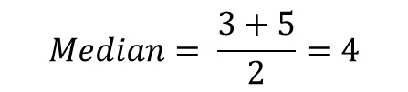


Median of Two Sorted Array
Divide Conquer and Combine Approach:
Base Case-2: if n=2
B =
A =
B[0]
B[1]
A[0]
A[1]
$$Median= \frac{Max\left\{A\left[0\right], B[0]\right\} + Min\{A\left[1\right], B\left[1\right]\}}{2}$$
Example:
A+B =
$$Median= \frac{3+5}{2}=4$$
B =
1
3
5
7
A =
1
7
3
5
$$Median= \frac{Max\left\{3,1\right\} + Min\{5, 7\}}{2}=\frac{3+5}{2}=4$$

Slide 16
Median of Two Sorted Array
Divide Conquer and Combine Approach:
If n>2:
Step-1: Compute the Median m1 and m2 of A and B respectively
A
 |  |  |  | m1
B
 |  |  |  | m2
Step-2: Compare m1 and m2
2.1: if m1 = m2 then return m1

Slide 17
Median of Two Sorted Array
2.1: if m1 < m2
A
+
B
 |  |  |  | m1
 |  |  |  | m2
Numbers less than m1
Numbers more than m2
Median will lie here
A
 |  |  |  | m1
B
 |  |  |  | m2

Slide 18
Median of Two Sorted Array
A’
A
 |  |  |  | m1
B
 |  |  |  | m2
B’
Compute the median of A’ and B’ recursively

Slide 19
Median of Two Sorted Array
2.2: if m1 > m2
A
+
B
 |  |  |  | m2
 |  |  |  | m1
Numbers less than m2
Numbers more than m1
Median will lie here

Slide 20
Median of Two Sorted Array
A’
A
 |  |  |  | m1
B
 |  |  |  | m2
B’
Compute the median of A’ and B’ recursively

Slide 21
Median of Two Sorted Array
A
1 | 3 | 5 | 7 | 9 | 11 | 13 | 15 | 17 | 19 | 21
n=11
B
2 | 4 | 6 | 8 | 10 | 12 | 14 | 16 | 18 | 20 | 22
n=11
m1=11
<
m2=12
A’
11 | 13 | 15 | 17 | 19 | 21
B’
2 | 4 | 6 | 8 | 10 | 12
m1=16
>
m2=7
A’
11 | 13 | 15
B’
8 | 10 | 12
m1=13
>
m2=10

Slide 22
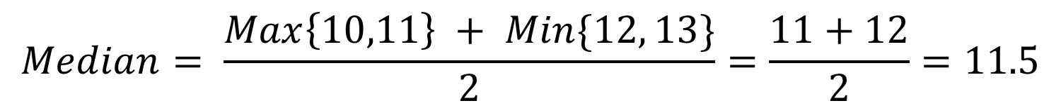
Median of Two Sorted Array
A’
11 | 13 | 15
B’
8 | 10 | 12
m1=13
>
m2=10
A’
11 | 13
Base Case
B’
10 | 12
$$Median= \frac{Max\left\{10,11\right\} + Min\{12, 13\}}{2}=\frac{11+12}{2}=11.5$$

Slide 23
Median of Two Sorted Array
Steps:
Find the medians of the given two arrays and store them in variable say m1 and m2.
Now, if m1=m2, then that will be the required output.
If m1<m2, then we check in the subarrays, arr1[middle element - last] and in arr2[0 - middle element].
If m1>m2, then we check in the subarrays, arr1[0 - middle element] and in arr2[middle element - last ].
This will be the recursive process and repeat this till size of both the arrays become 2.
when the size will be 2 , we can use the formula :
Median = (max(ar1[0], ar2[0]) + min(ar1[1], ar2[1]))/2

Slide 24
Median of Two Sorted Array
Time Complexity = O(log2n) = O(logn)

Slide 25
Max-Min problem

Slide 26
The Max-Min problem involves finding the maximum and minimum elements in an array. Using the Divide and Conquer method, the problem is solved by dividing the array into smaller subarrays, solving the problem for these subarrays, and then combining the results to find the final maximum and minimum.
Algorithm:
Divide:
Split the array into two halves until each half contains only one or two elements.
Conquer:
If the subarray contains a single element, both the maximum and minimum are the same (that element).
If the subarray contains two elements, compare them to find the maximum and minimum.
Combine:
Recursively merge results from the two halves by comparing their maximums and minimums to determine the overall maximum and minimum.

Slide 27
MaxMin(arr, low, high):
If low == high:
Return (arr[low], arr[low]) // Single element: max and min are the same
Else If high == low + 1:
If arr[low] > arr[high]:
Return (arr[low], arr[high]) // Two elements
Else:
Return (arr[high], arr[low])
Else:
mid = (low + high) / 2
(max1, min1) = MaxMin(arr, low, mid)
(max2, min2) = MaxMin(arr, mid + 1, high)
overall_max = max(max1, max2)
overall_min = min(min1, min2)
Return (overall_max, overall_min)

Slide 28
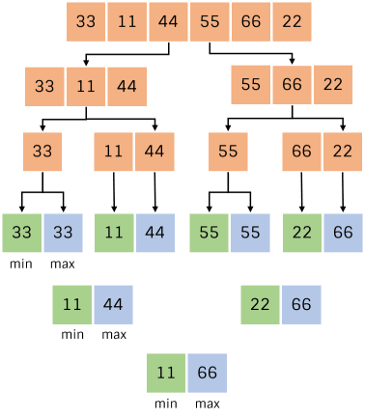
Complexity:
Time Complexity: O(n) as each element is compared at most once during merging.
Space Complexity: O(log⁡n), due to the recursion stack

